Slide 1
PROGRAMMING
(FINALS)

Slide 2
Saint John Bosco I.A.S
(APPLICATION)
- It is an application that every student of St. John Bosco can use
- Easy to use and to access
- Highly secured interface

Slide 3
STUDENT LOGIN FORM
- In computer security, logging in is the process by which an individual gains access to a computer systems by identifying and authenticating themselves.
- It is use to keep Email account, Profiles, Credit cards and Bank accounts safe and secured from other people
- Needs USERNAME and PASSWORD in order to login

Slide 4
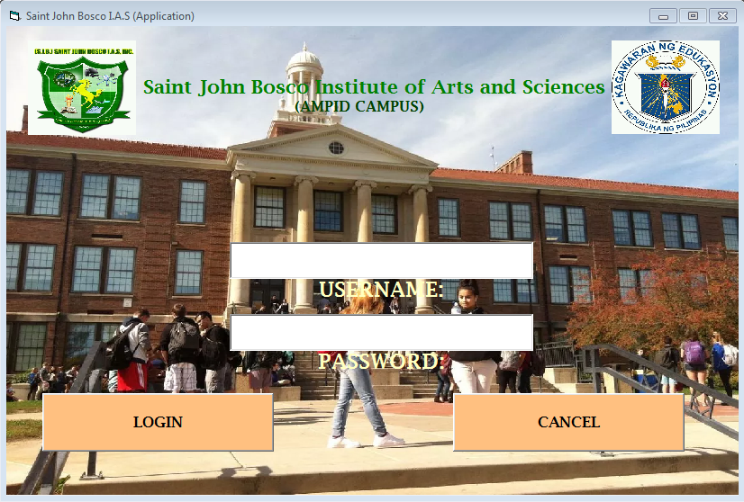

Slide 5
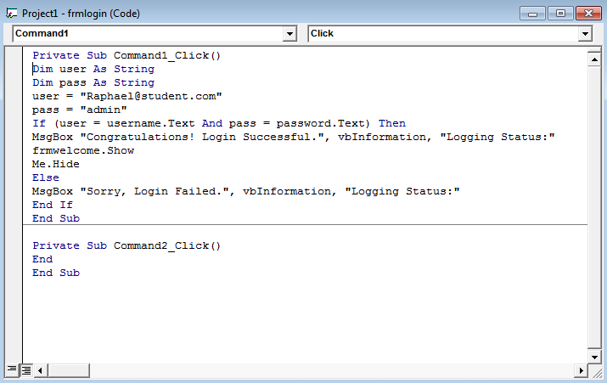
Codes:

Slide 6
There are THREE (3) features or things you can choose to do after Logging In:
1. Student Registration Form
2. Quiz Bee
3. Average Grade Calculator

Slide 7
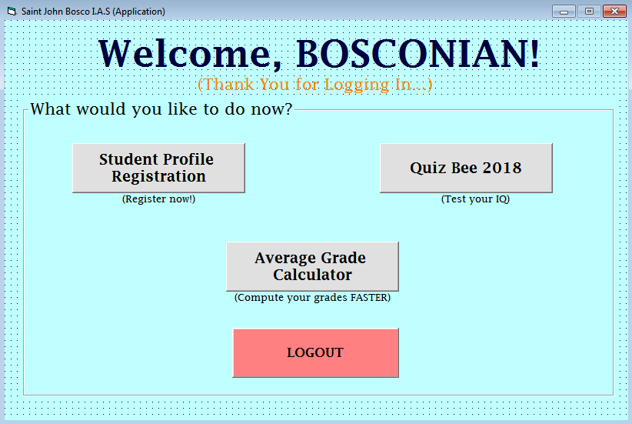
The user’s interface:

Slide 8
1. Student Registration Form
- It is a form which you can fill up the needed information for student such as NAME, AGE, BIRTHDAY and etc.
- It is used when registering or filling up something like adding new information, changing or updating your current status
- It is commonly use when submitting a new profile, account or updating data

Slide 9
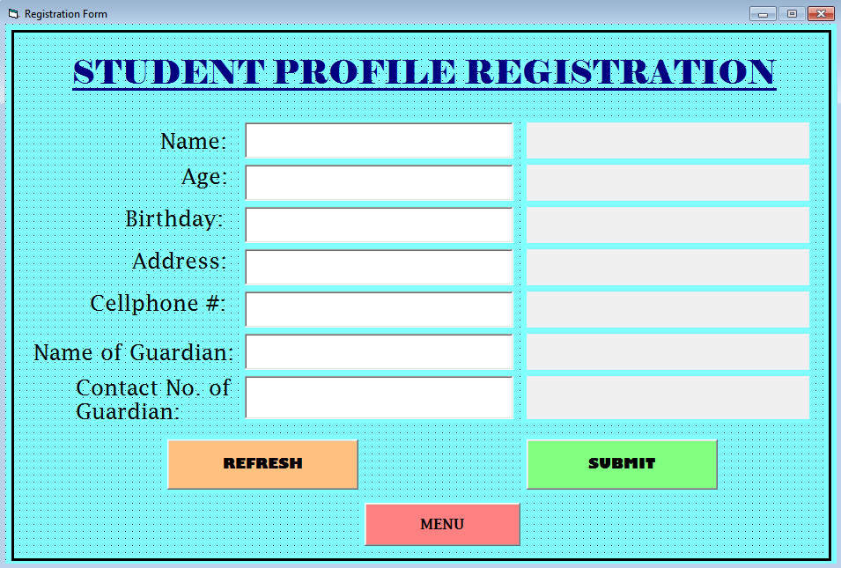

Slide 10
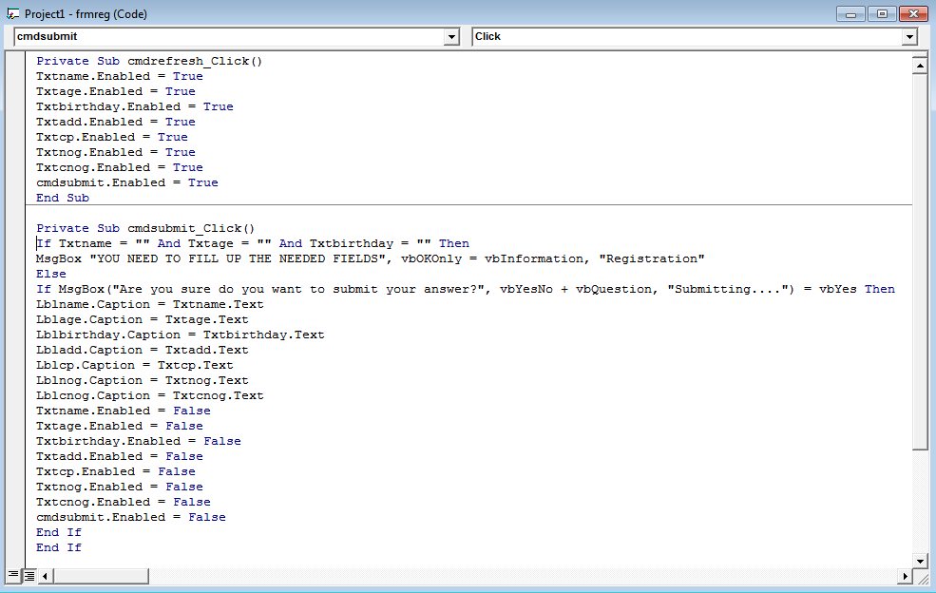
Codes:

Slide 11
2. Quiz Bee/ Modern Quiz Bee
- It is a way of a teacher/instructor will know if you learn to the lesson that they taught
- It is commonly mixed with assorted subjects/topics to know how smart or how brainy student he/she is
- It is now mixed with a timer for every questions to be answer before the time runs out

Slide 12
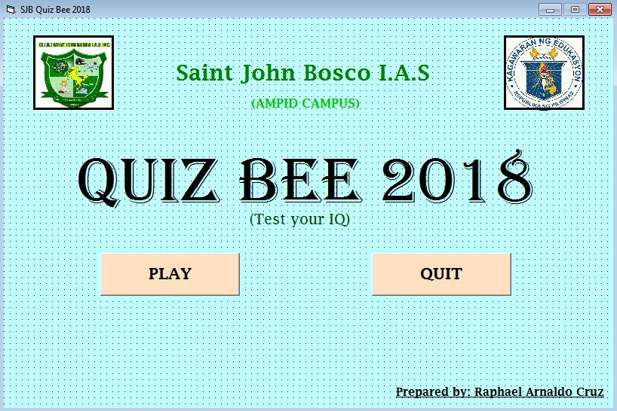

Slide 13
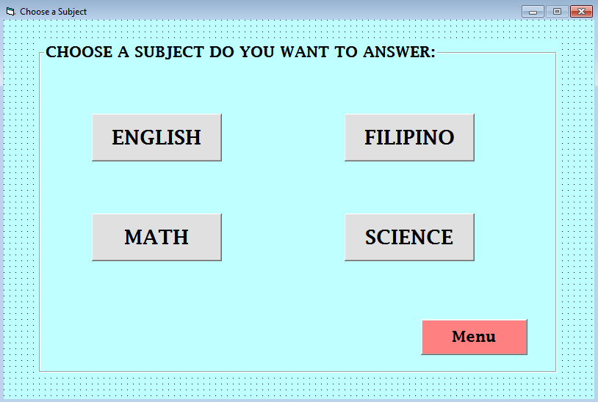

Slide 14
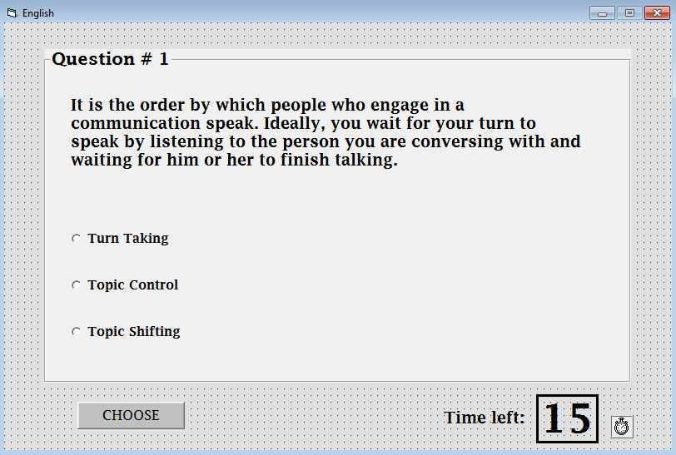
(Example Question For Quiz)
Question
Possible answers
Timer

Slide 15
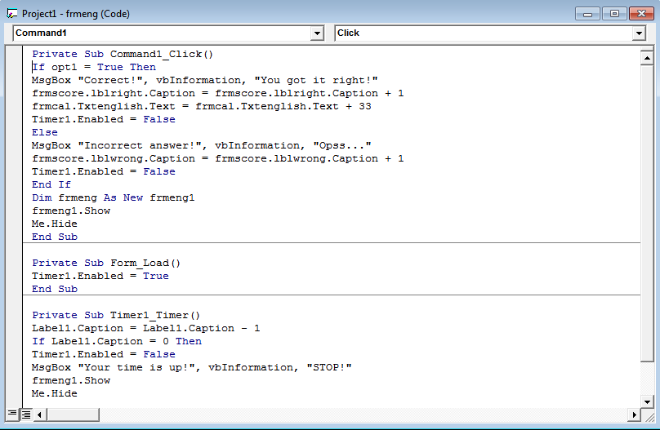
Codes (Quiz Question):

Slide 16
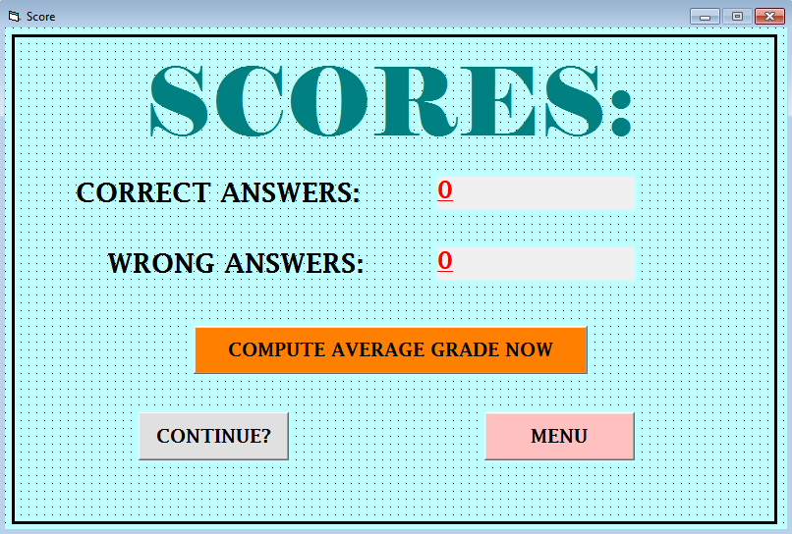

Slide 17
3. Average Grade Calculator
- An average is a single number taken as representative of a list of numbers
- It is used to compute grades FASTER
- It is more efficient than calculating it manually
- It is commonly used by Teachers especially when computing grades and by Manager, to compute the overall expenses and income of their company

Slide 18
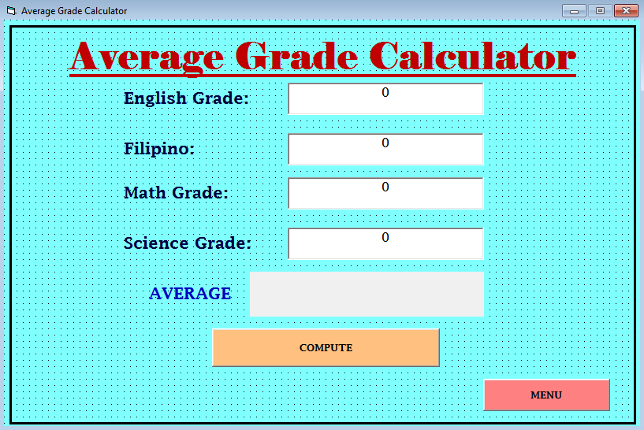

Slide 19
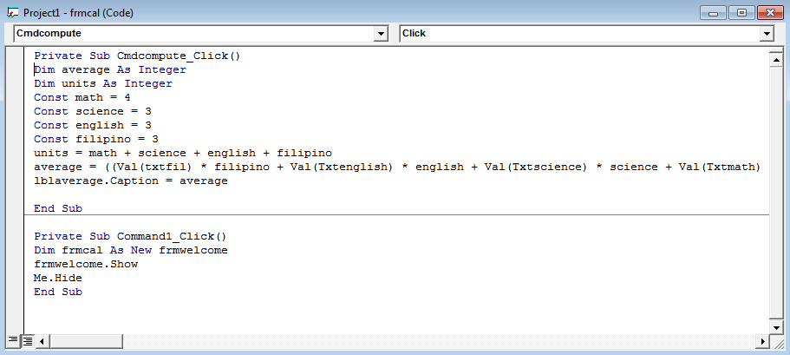
Codes:

Slide 20
“THANK YOU FOR LISTENING”

